Slide 1
Recommendation systems
- ARPAN SINGH_[ K1 ]_[ 53 ]

Slide 2
INTRODUCTION
A recommendation system is a kind of information filtering system that makes most out of the data given to it and to make predictions upon it . These have a great range of operations . These systems are often useful for gathering and processing large amount of data for websites , Apps , and other e-commerce
KEY FEATURES
High Quality Recommendation
Literature Surveys
Vectorization techniques
Finding out Similarity Behaviours
Product analysis .
For example, Facebook may display colourful stories about your transactions in your news feed to determine the kinds of things that you find interesting.
A music streaming app - if it isn't able to predict and play songs they enjoy.
Furthermore, a user's taste can differ according on a variety of things, including as their mood, the time of year, and the kind of exercise they engage in

Slide 3
Movie Recommendation system_
As the name suggests this type of systems are used to utilize data of movies on a streaming service and make sure each user using that site gets personalized recommendations of movies .
Based on the activity of user and the keywords entered it gives output.
For recommender systems, there are three primary methods that are widely employed.
1 . Content-based filtering
2 . Collaborative filtering
3 . Hybrid

Slide 4




Here, we'll integrate the Hybrid filtering approach with the Flask framework in Python. The process involves gathering and analysing user activity data. This includes analysing the user's online behaviour and speculating about their preferences by comparing them to other users.
PREFERENCE
PAST ACTIVITY
PROVIDED FILTERS
VECTORIZATION
DATA PREPROCESING

Slide 5

Core concepts used
Literature Survey
Hybrid filtering
Matrix factorization
Bag of words method
Cosine Similarity

Slide 6
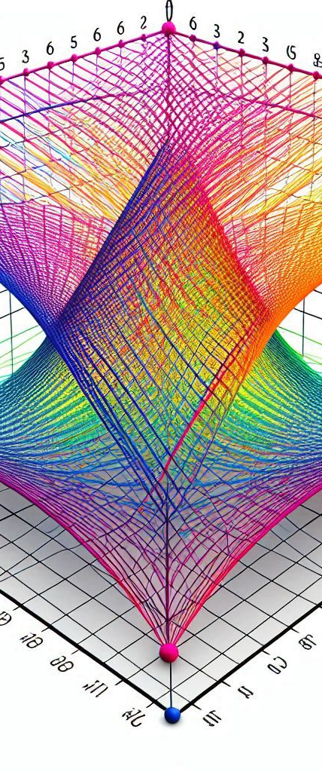
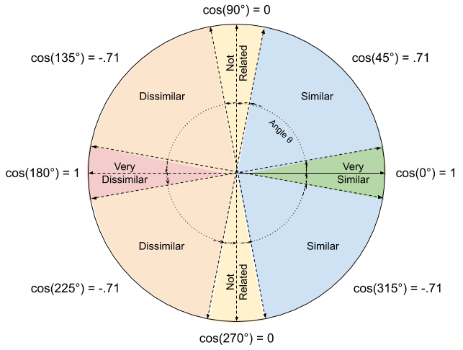
Cosine similarity
[ Why not Euclidian Distance ? ]
Cosine similarity is a statistic used to compare the similarity of two vectors. Comparing two users' or two things' similarity is a common use case for recommender systems.
Cosine similarity can be used to compare the similarity between two consumers' movie ratings or two movies' features, like actor, director, or genre, in the context of movie recommender systems

Slide 7

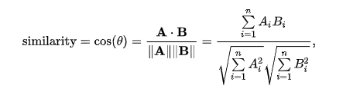
More about [ cosine similarity ] -
It is necessary to first represent each data point as a vector in order to compute the cosine similarity between two data points. One possible way to display user movie ratings is as a vector, with each element of the vector denoting a user's rating for a certain film. Comparably, we can use a vector to represent the features of a video, with each element in the vector denoting a distinct feature.
A value between 0 and 1 represents the cosine similarity between two vectors. When two vectors have a cosine similarity of 1, it means they are the same, and when it is zero, it means they are orthogonal, or perpendicular to each other

Slide 8

Getting data
The movie data is loaded by the program from a CSV file. By completing missing values and cleaning up the data, it carries out data preparation. It concatenates the genres, keywords, tagline, cast, and director features to produce a combined feature vector for every film.
The concatenated feature vectors are converted into a sparse matrix using a Tfidf Vectorizer. It determines each pair of movies' cosine similarity. The application uses difflib.get_close_matches() to locate a near match in the movies data when a user provides the name of a movie.
Next, the movie's index is obtained, and the cosine similarity matrix is used to determine which ten films are the most similar. In the end, the user receives the recommended movie list.

Slide 9
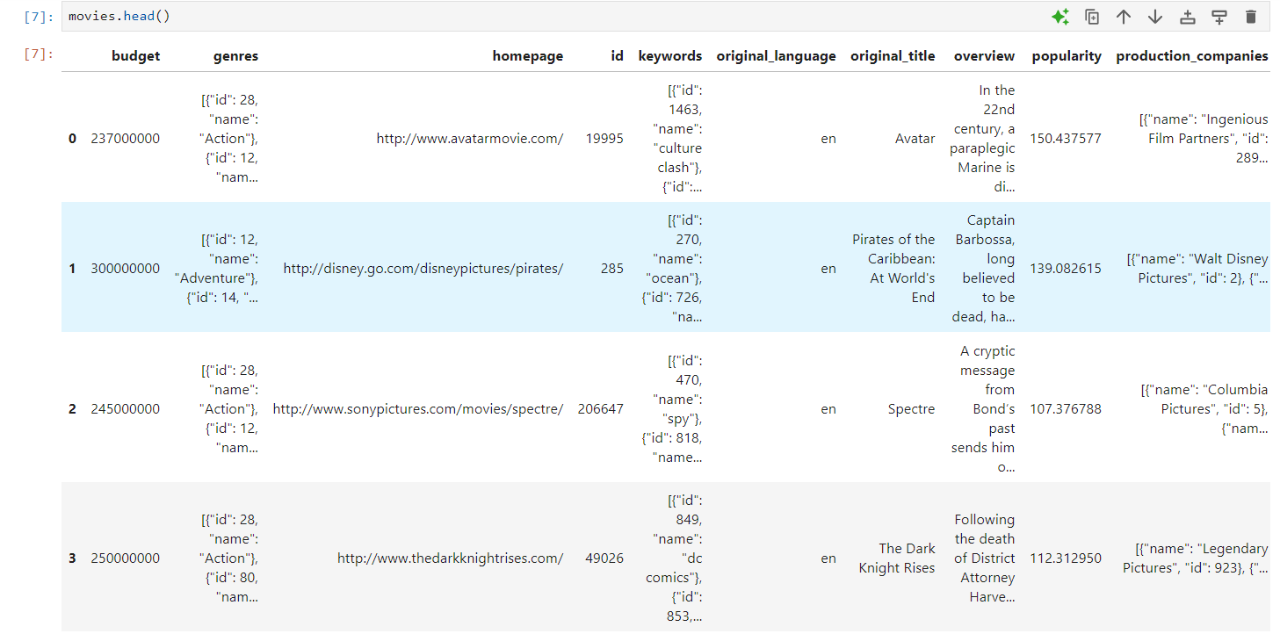
Operations on data -
Before Preprocessing

Slide 10
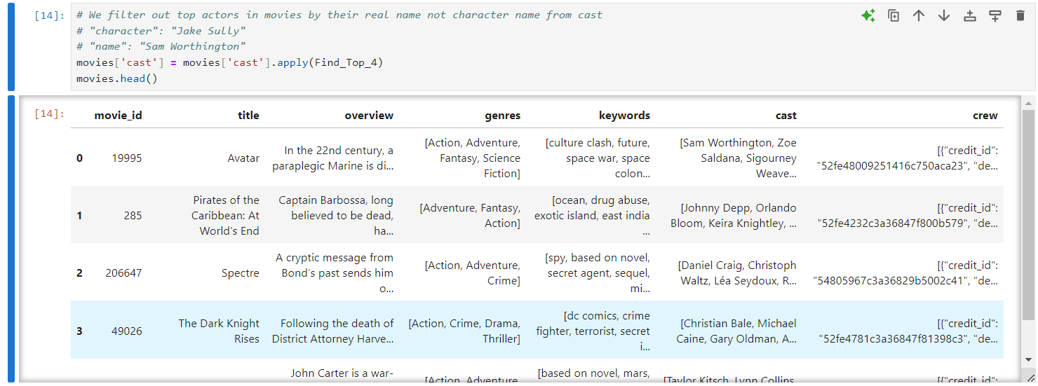
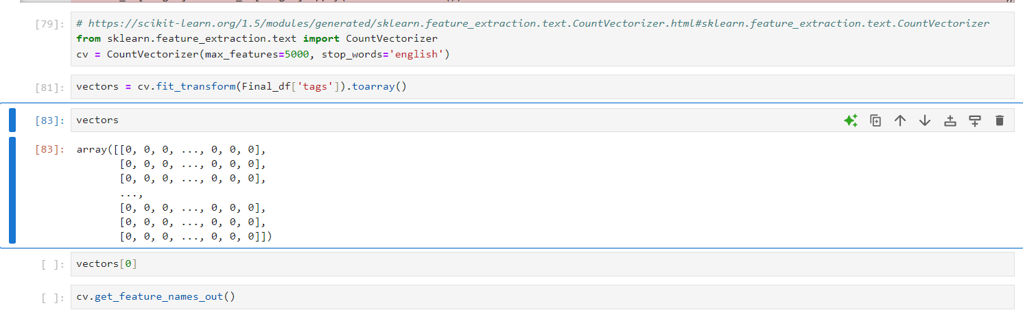
Final Dataset ( Filtered out)

Slide 11
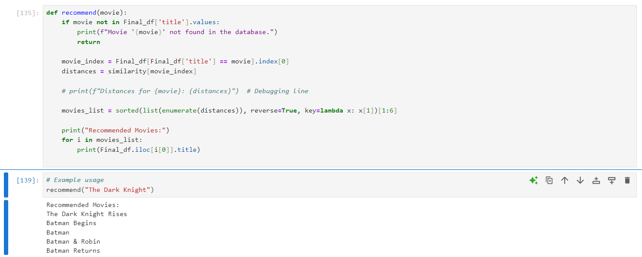
Final output

Slide 12
THANK YOU

